Slide 1
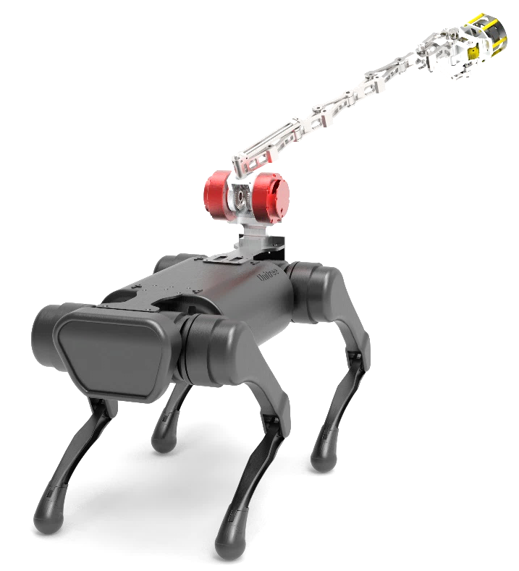
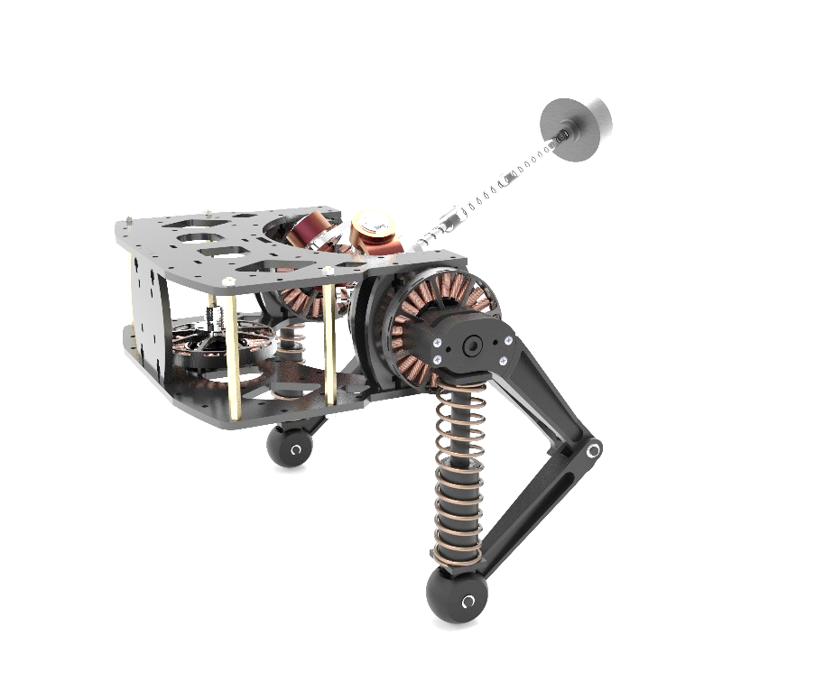
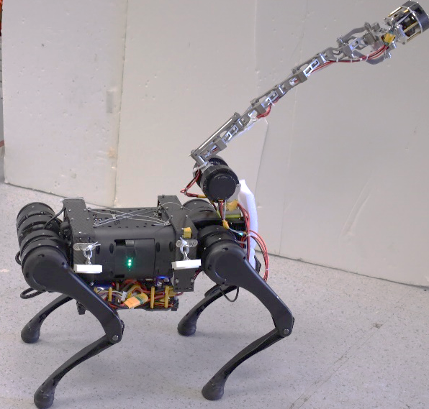
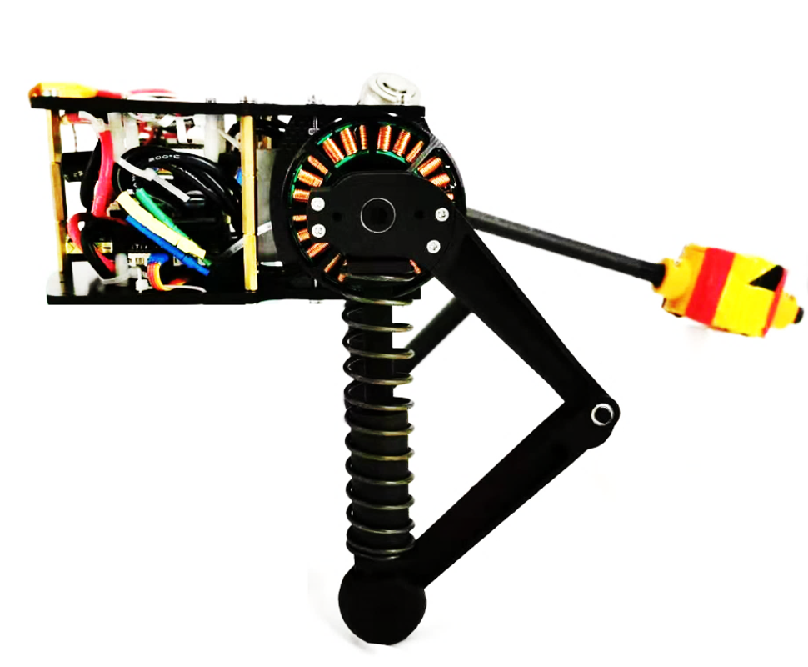

Slide 2
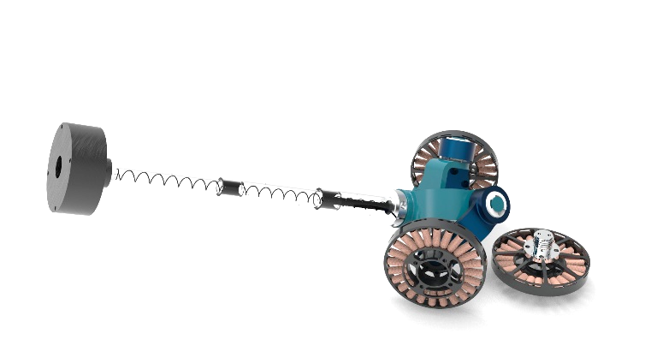
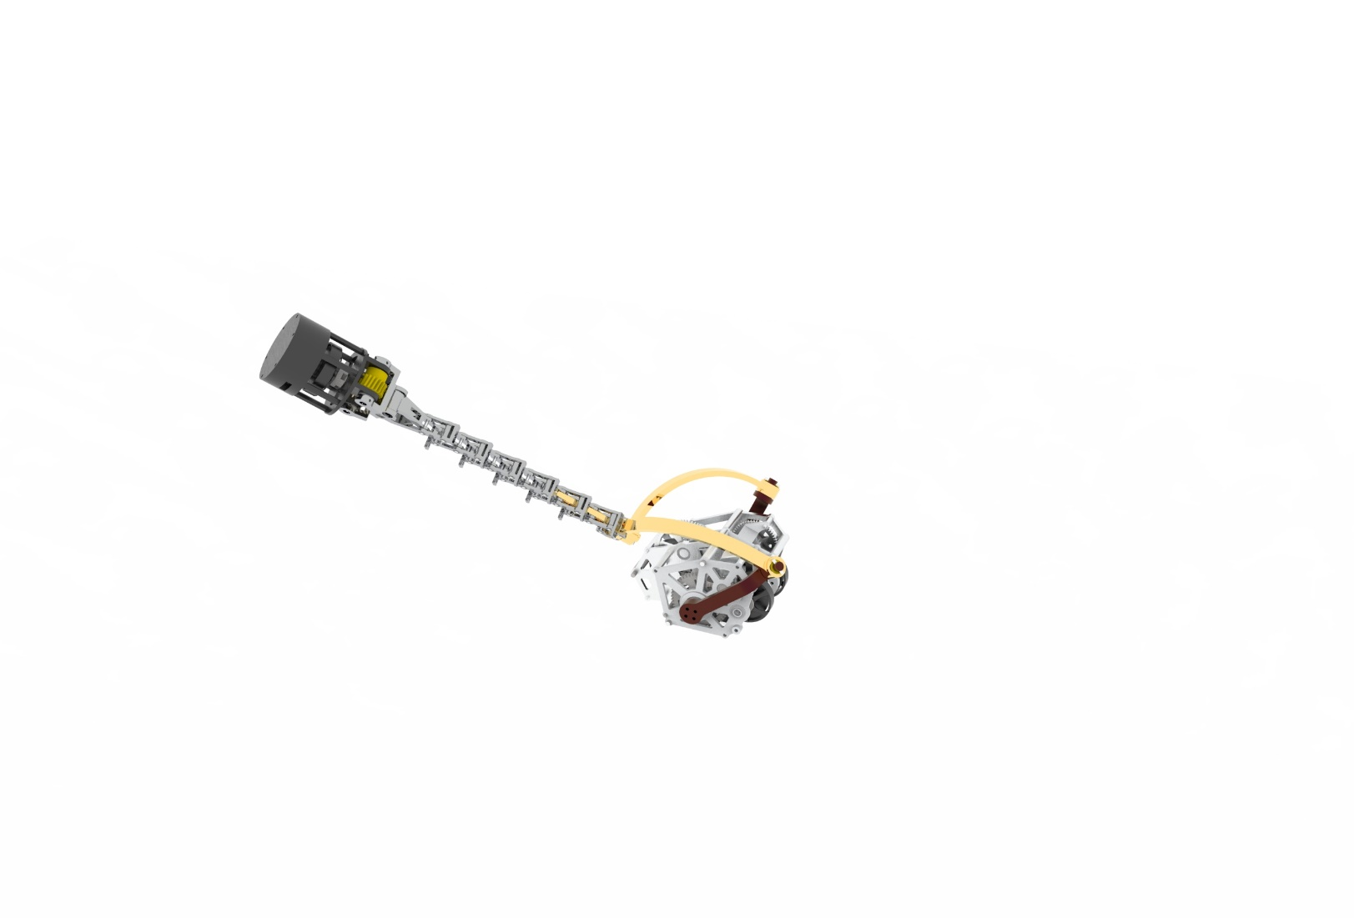
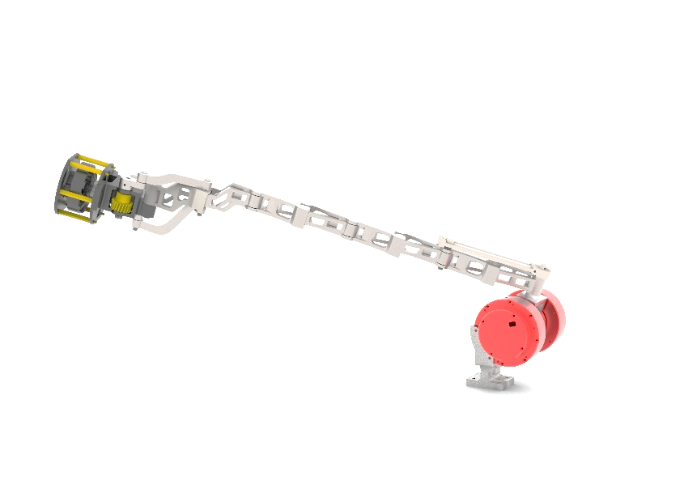
1

Slide 3
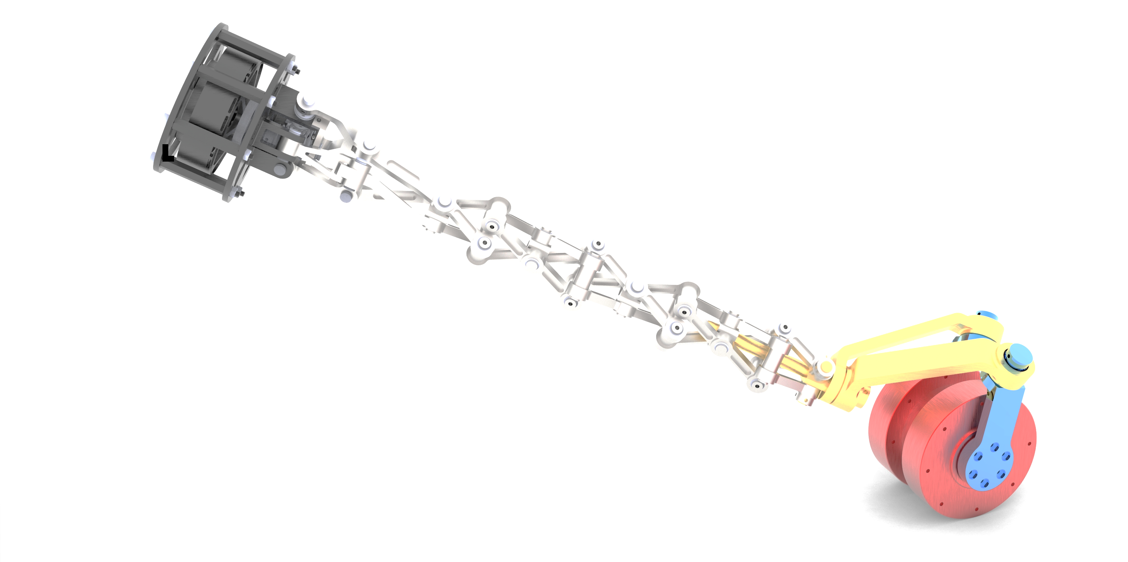
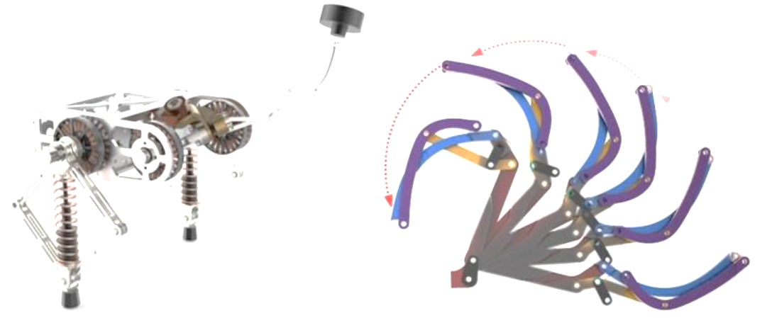

Slide 4
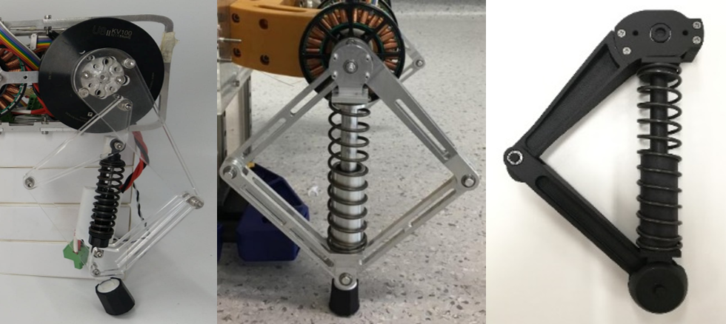
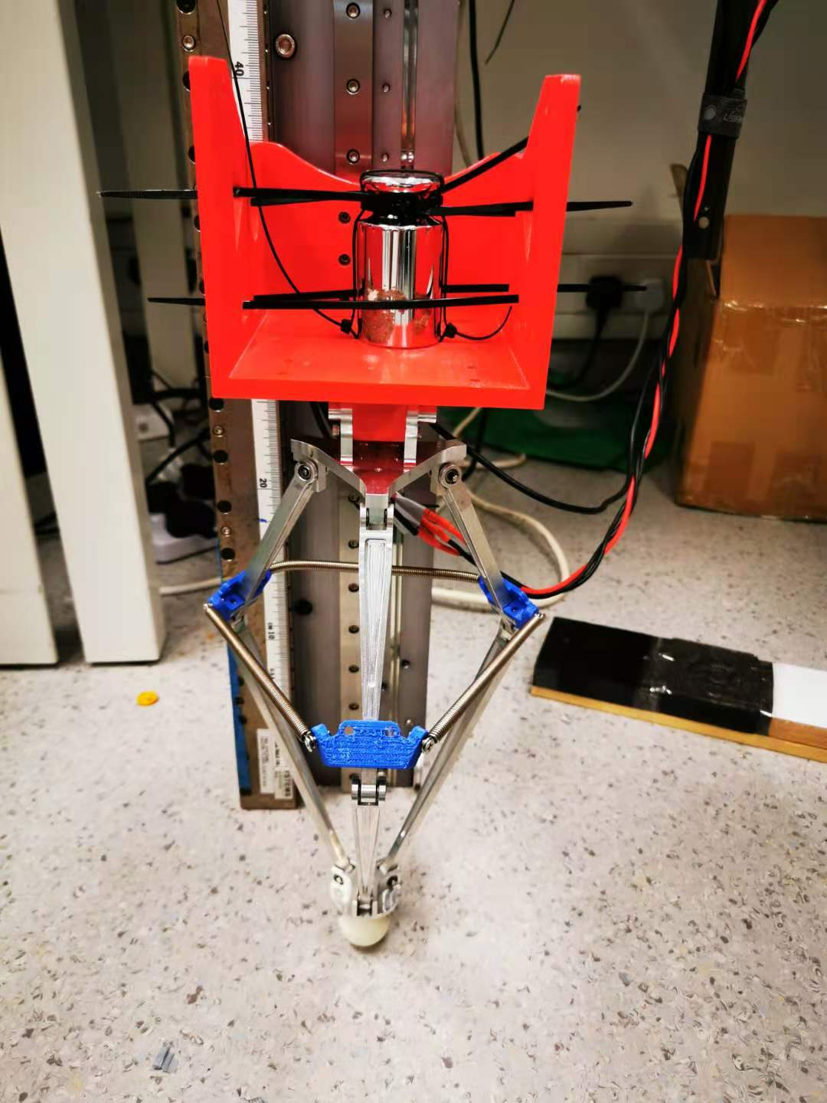
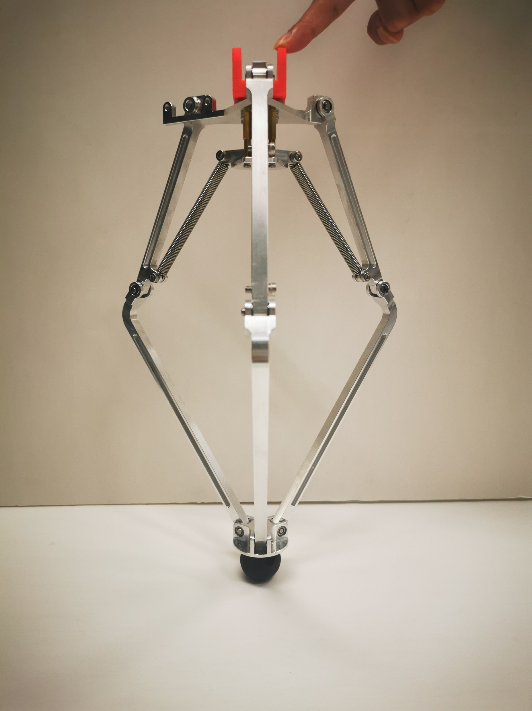
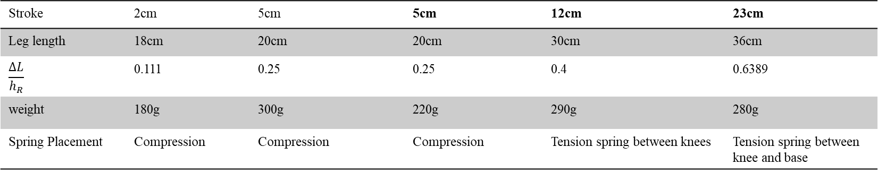
Stroke | 2cm | 5cm | 5cm | 12cm | 23cm
Leg length | 18cm | 20cm | 20cm | 30cm | 36cm
$$\frac{ΔL}{h_{R}}$$ | 0.111 | 0.25 | 0.25 | 0.4 | 0.6389
weight | 180g | 300g | 220g | 290g | 280g
Spring Placement | Compression | Compression | Compression | Tension spring between knees | Tension spring between knee and base

Slide 5
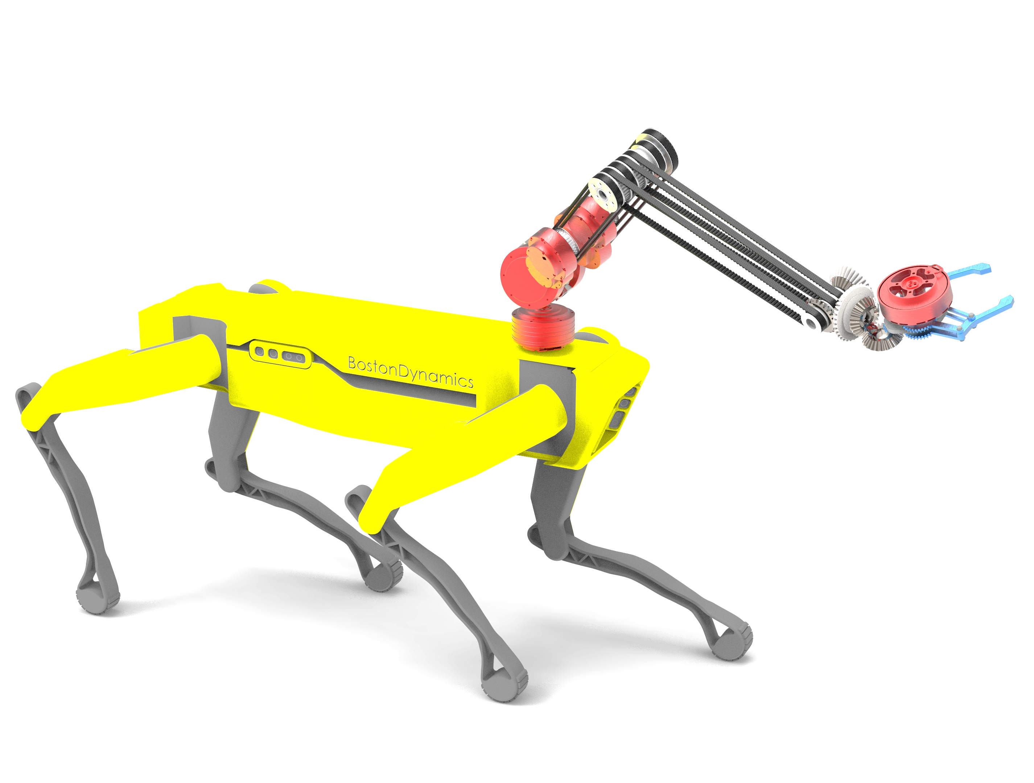

Slide 6
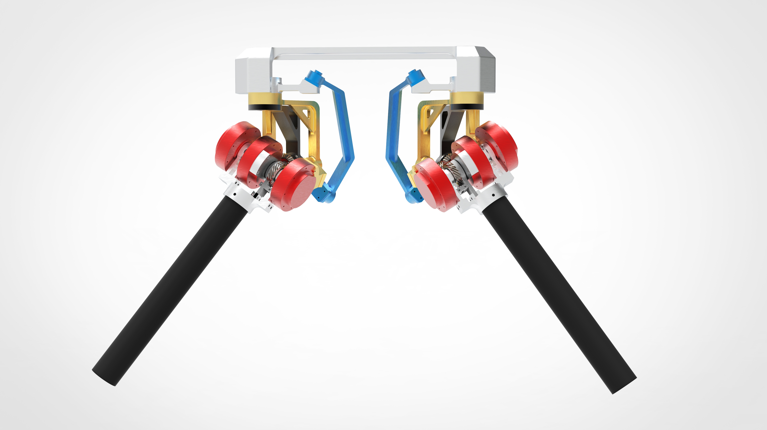
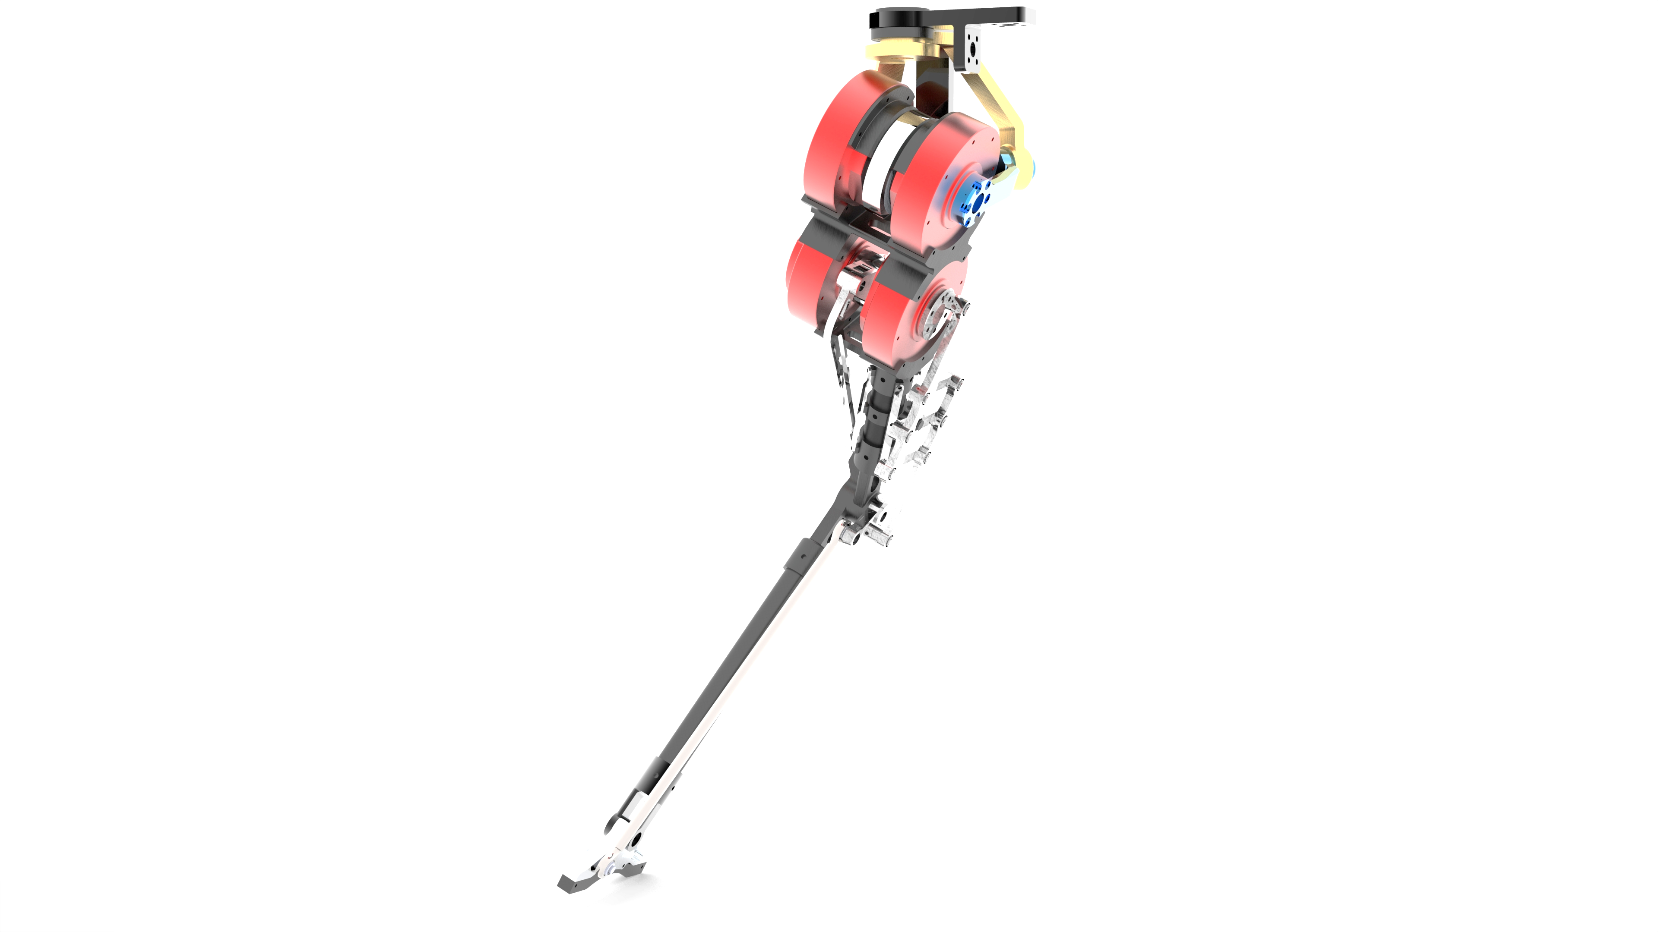
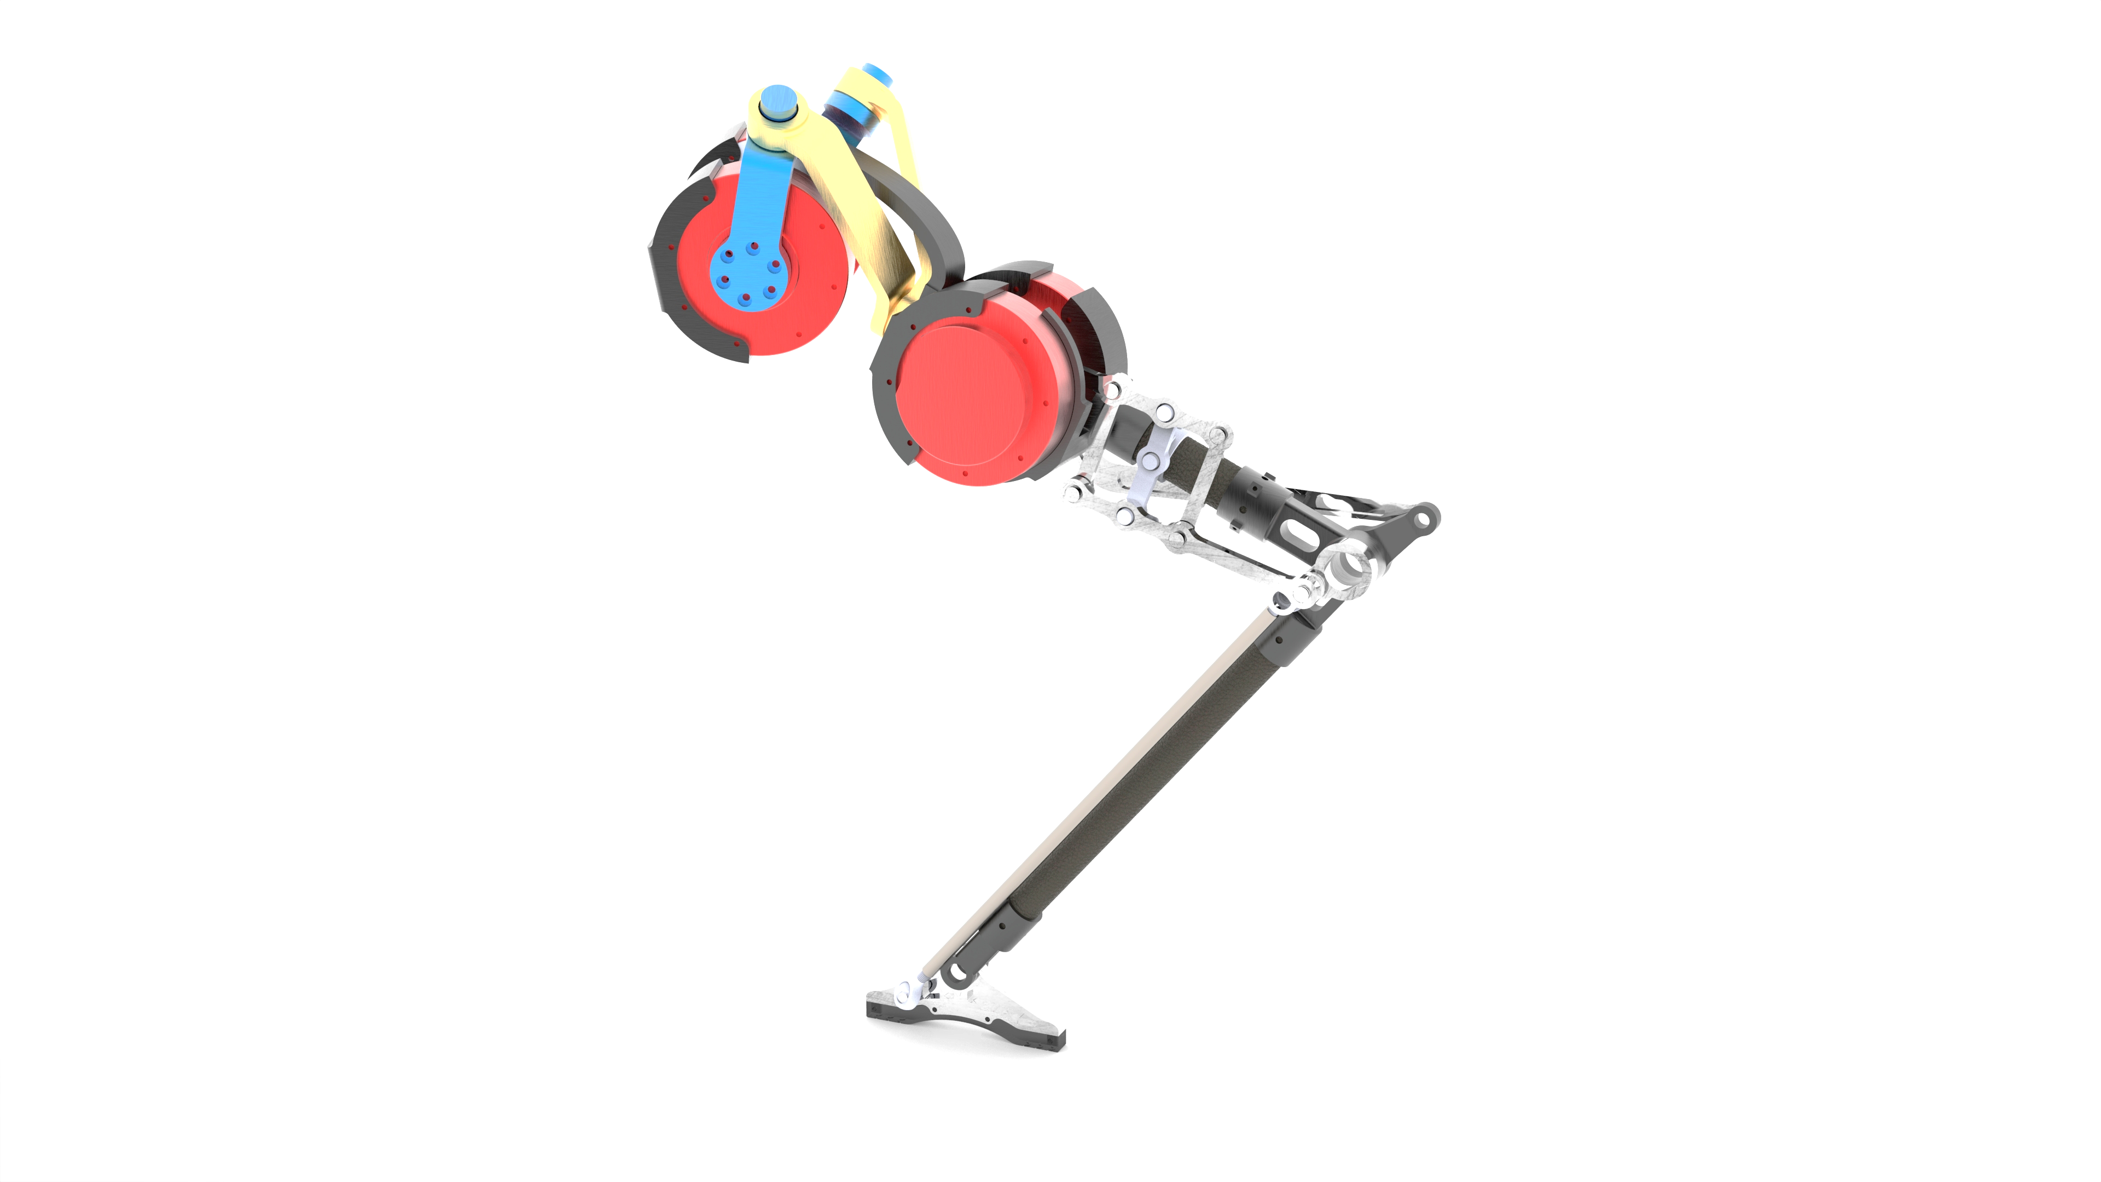
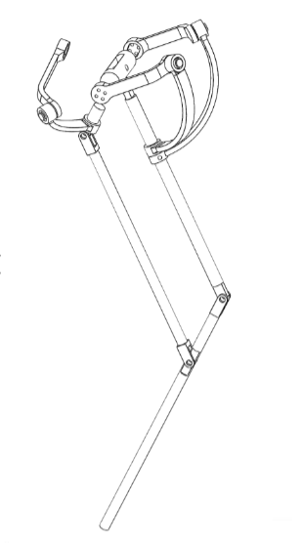

Slide 7
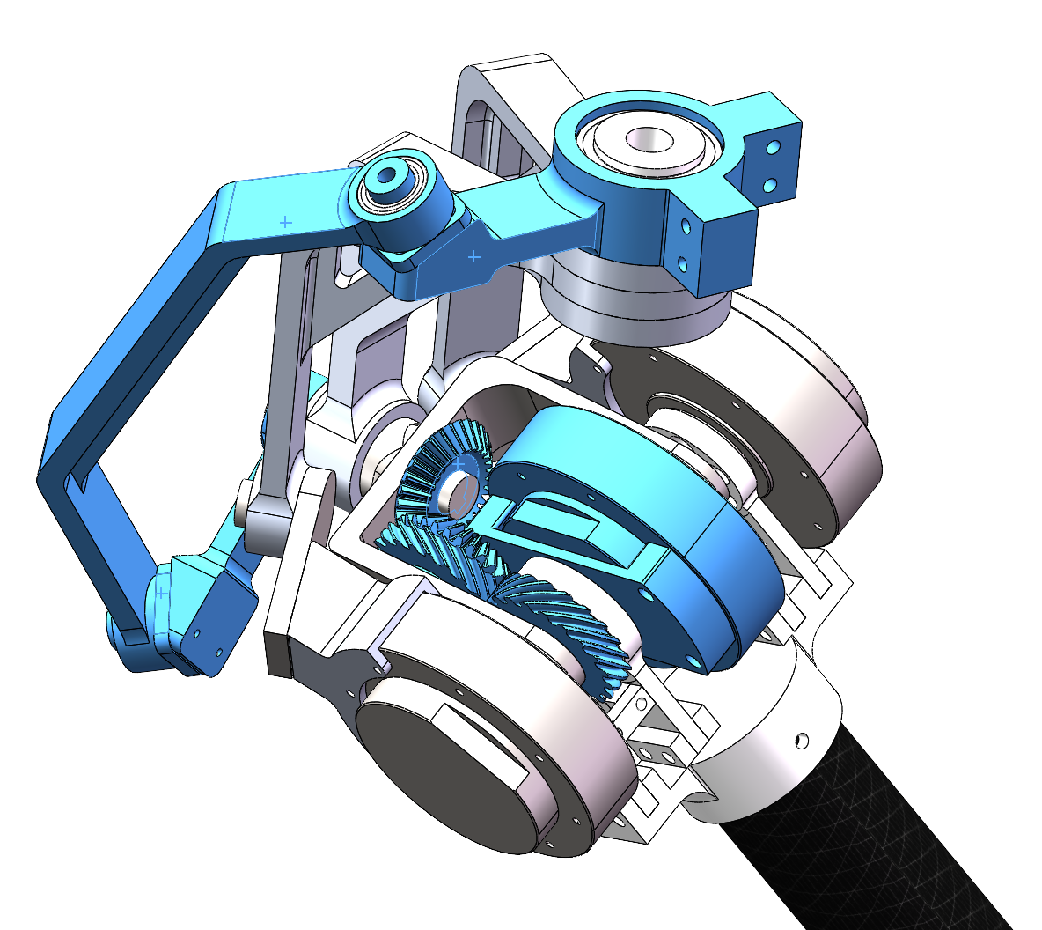
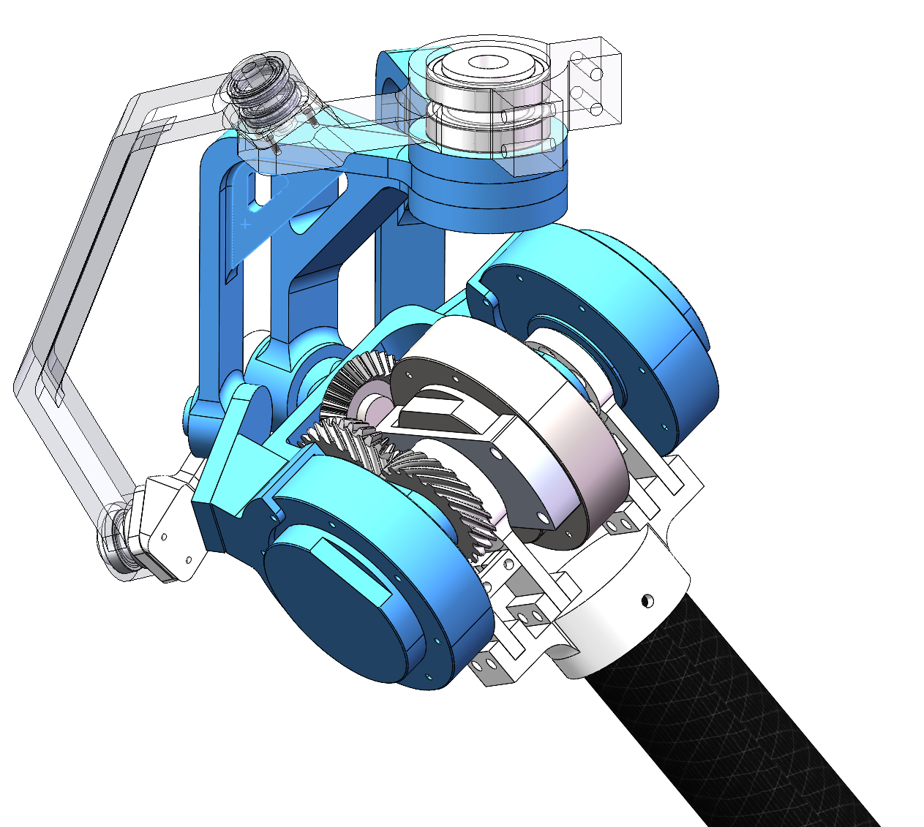
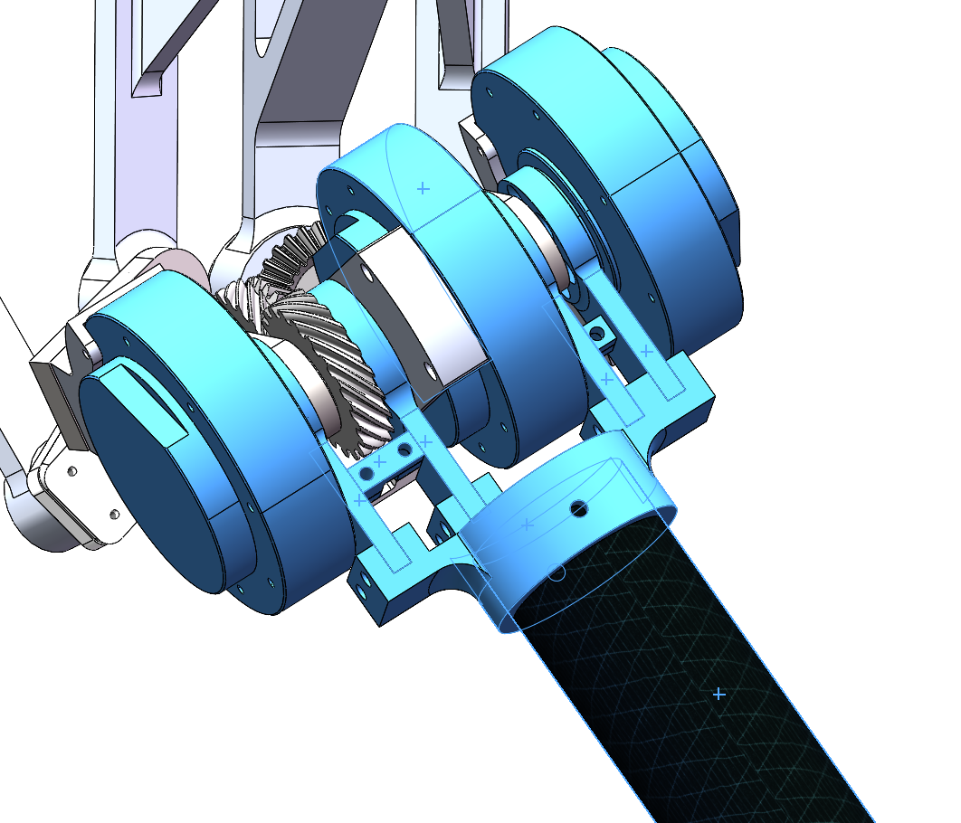
Coupled Double Differential Joint (CDD Joint)
First Differential Joint
Together Fixed Base
Abduction/Adduction DoF
2Motors: Based on SFB(spherical five bar linkage)
Yaw Motion DoF
1 Motor Control: Gear Transmission + 4-spherical-bar-linkage
Flexion/Extension DoF
3 Motors Swing together

Slide 8
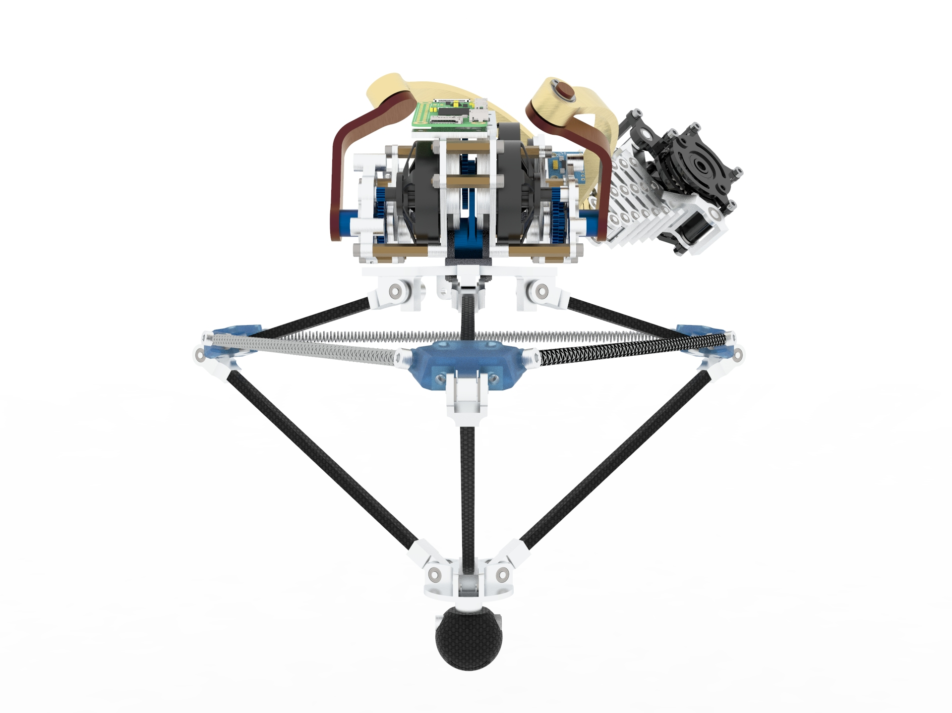

Slide 9
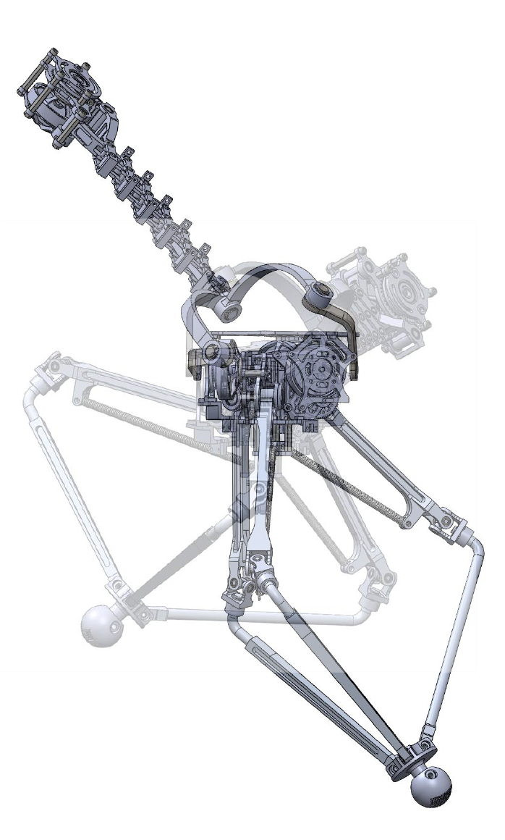
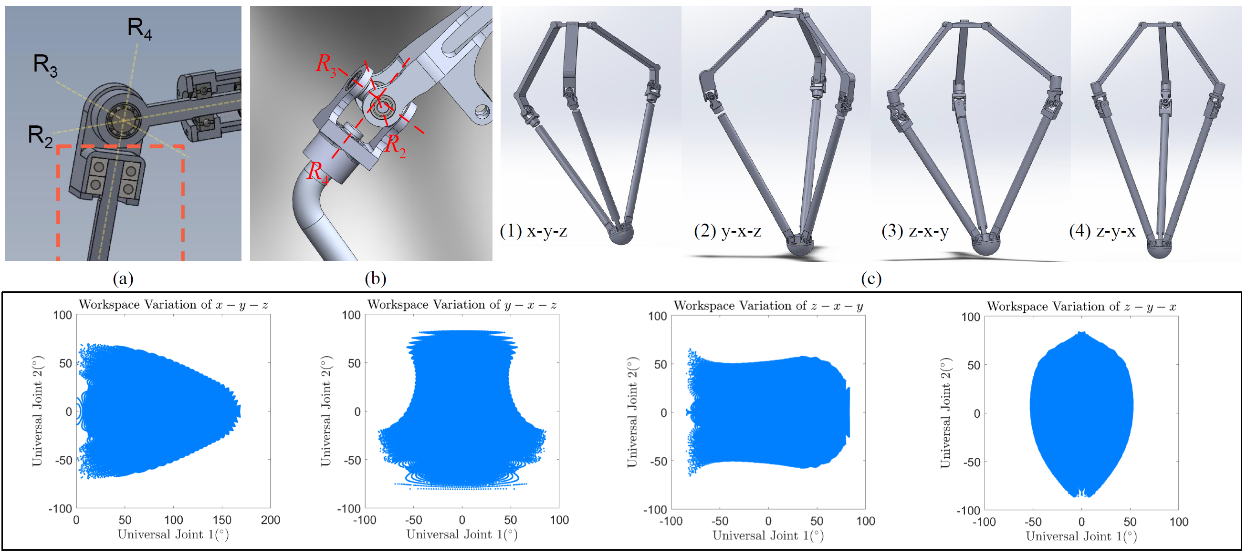
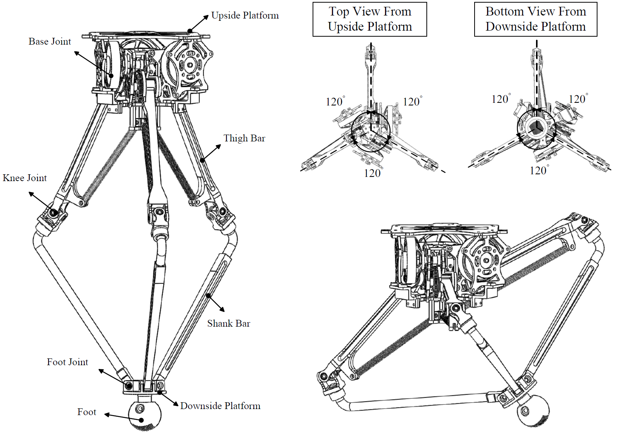
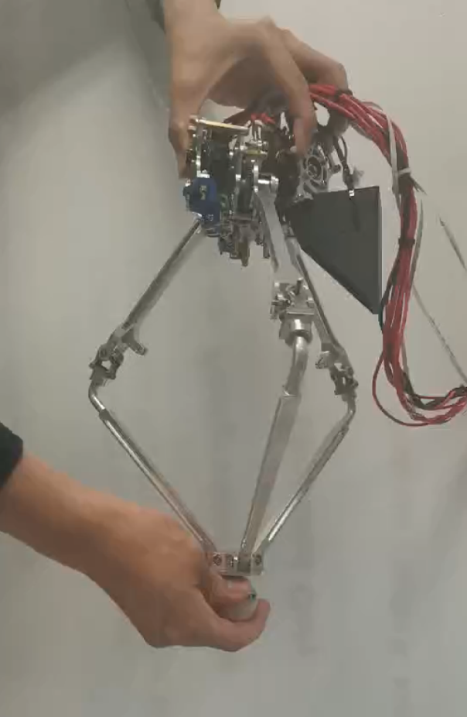
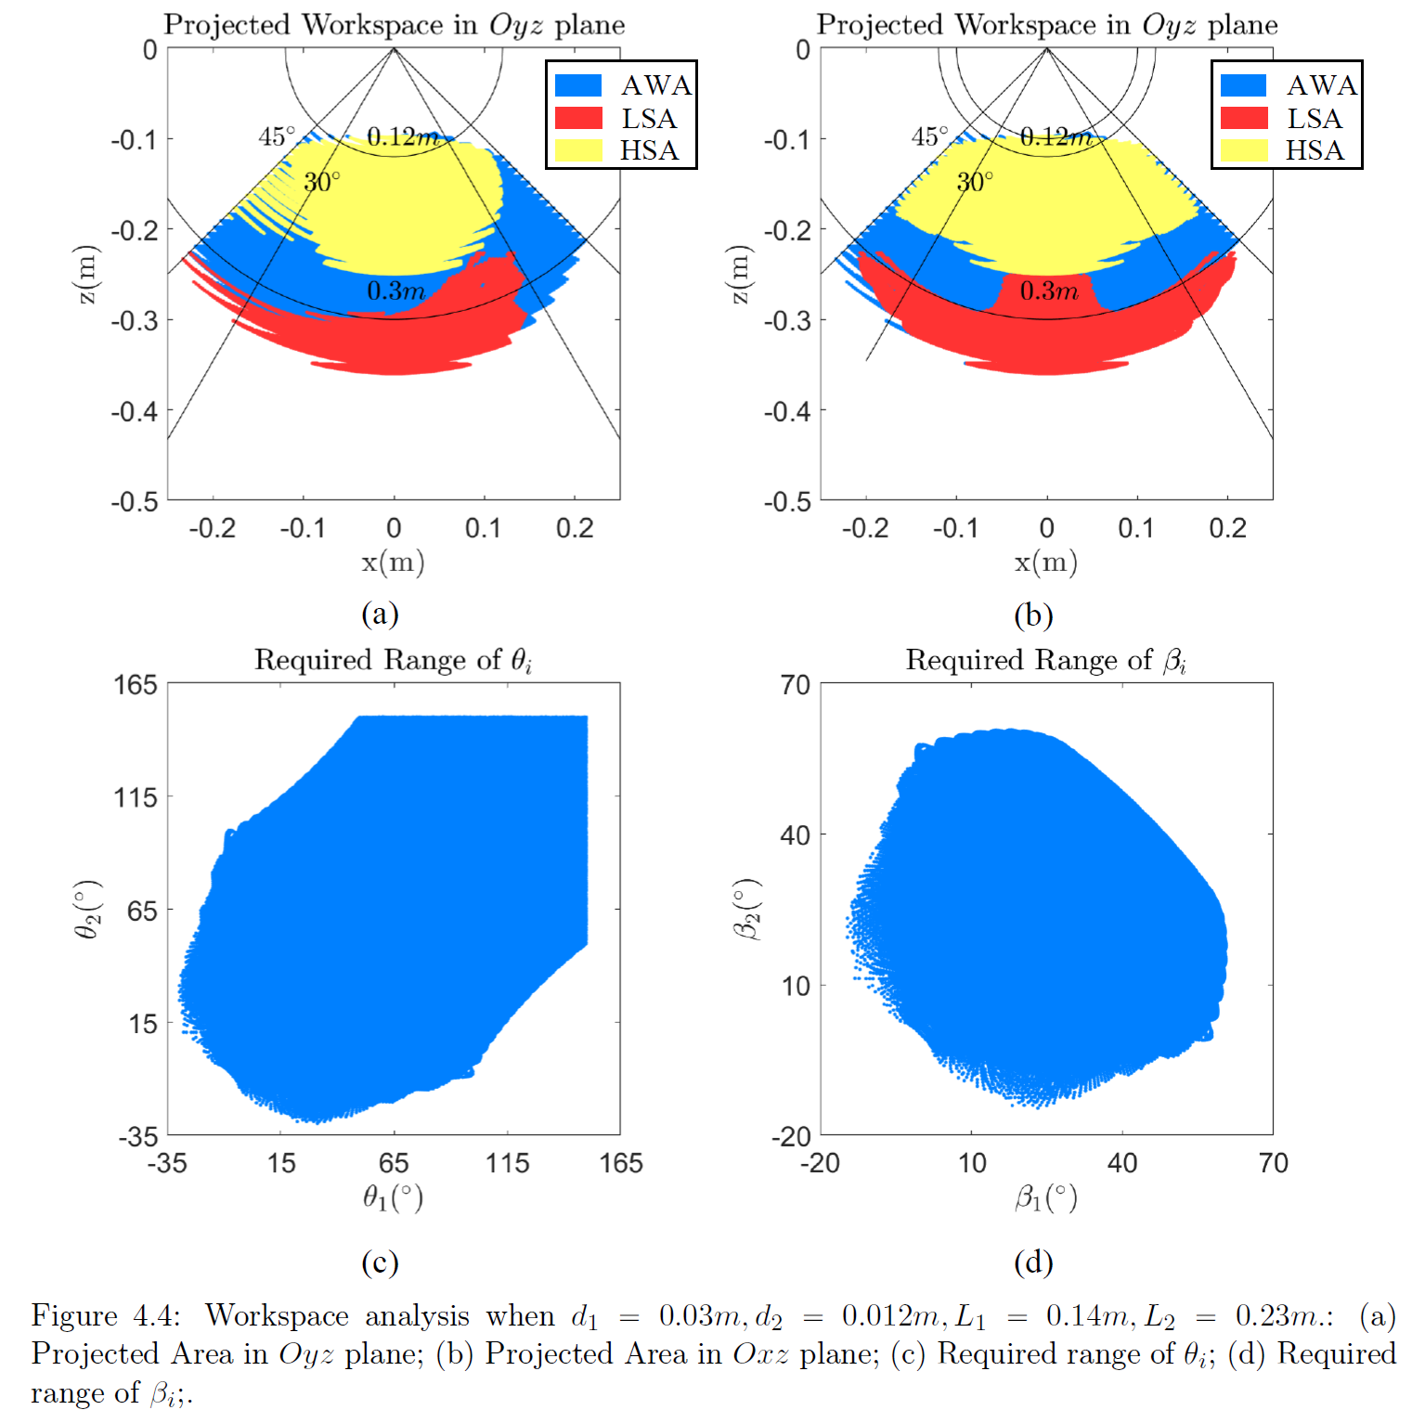
Design Overview
Joint Optimization
Leg Design
Spring Integration Analysis
Initial Prototype

